Slide 1
IFB299 presentation
The Sweaty Ants - Group 41
Natasha Peppler - Ferenc Gall - Joseph Dwyer - Katie Mitchell -
Nik Shafiq Sirhan - Taylor Green
Notes:
15 minute timeslot.

Slide 2

Problem Space
How do we improve our Data management system ?
How do we make it provide quality service to customers?
Notes:
Earlier this year we were approached by a company that had a problem.
Their current database and software was in need of an overhaul.
Their customer service quality was being affected by ___ and ____

Slide 3
Solution
Create a new, intuitive, and functional piece of software with a database.
Designed for use by employees and customers
Adds extra functionality like comparing prices and booking extras
Allows employees view and edit data
Notes:
We started to familiarise ourselves with the requirements of the company through ____.
Did ___ and _____ .
Solution: create a piece of software

Slide 4
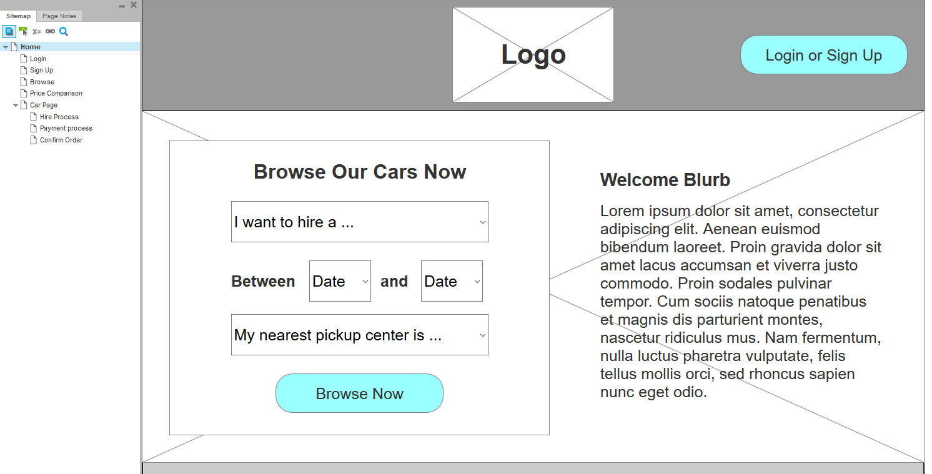
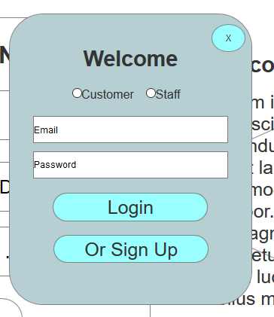
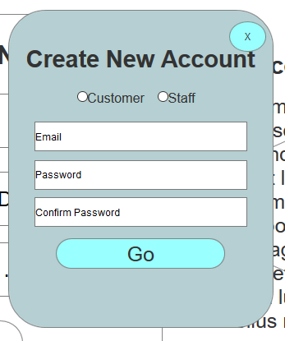
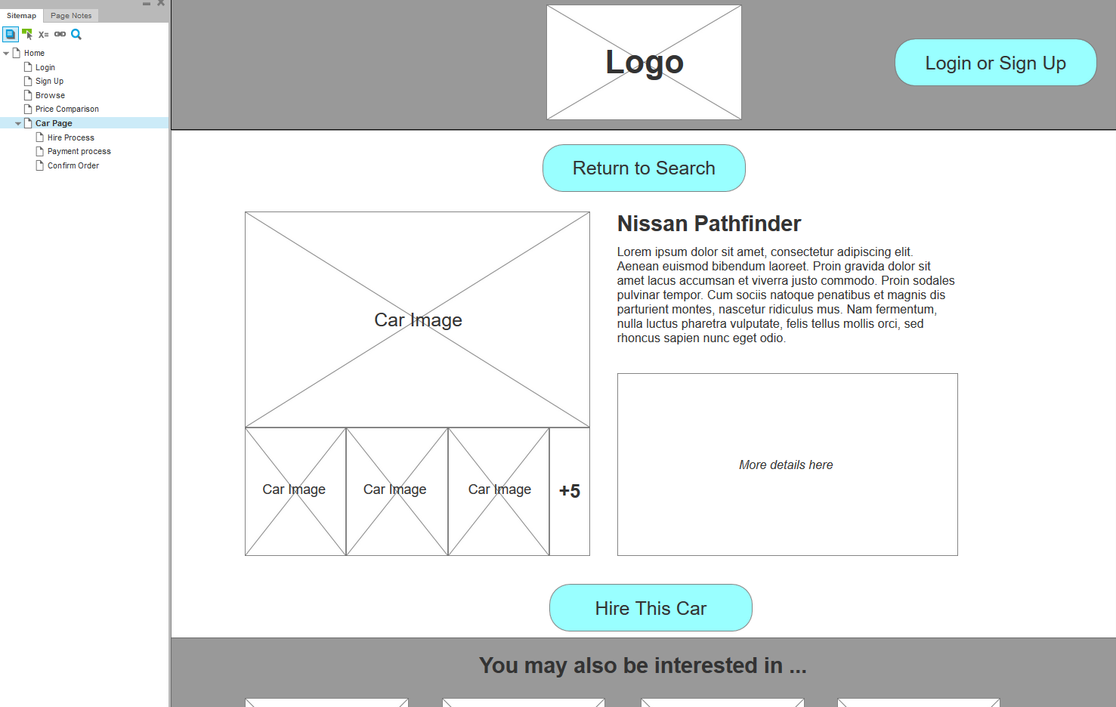
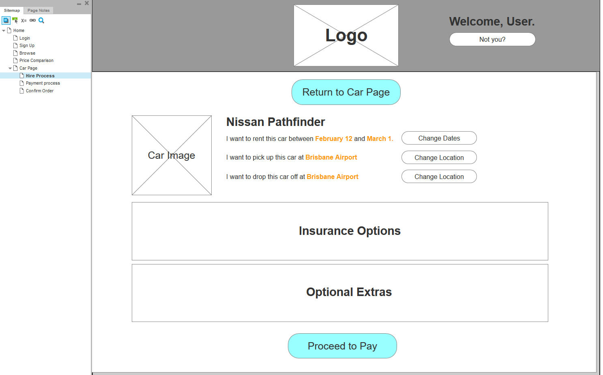
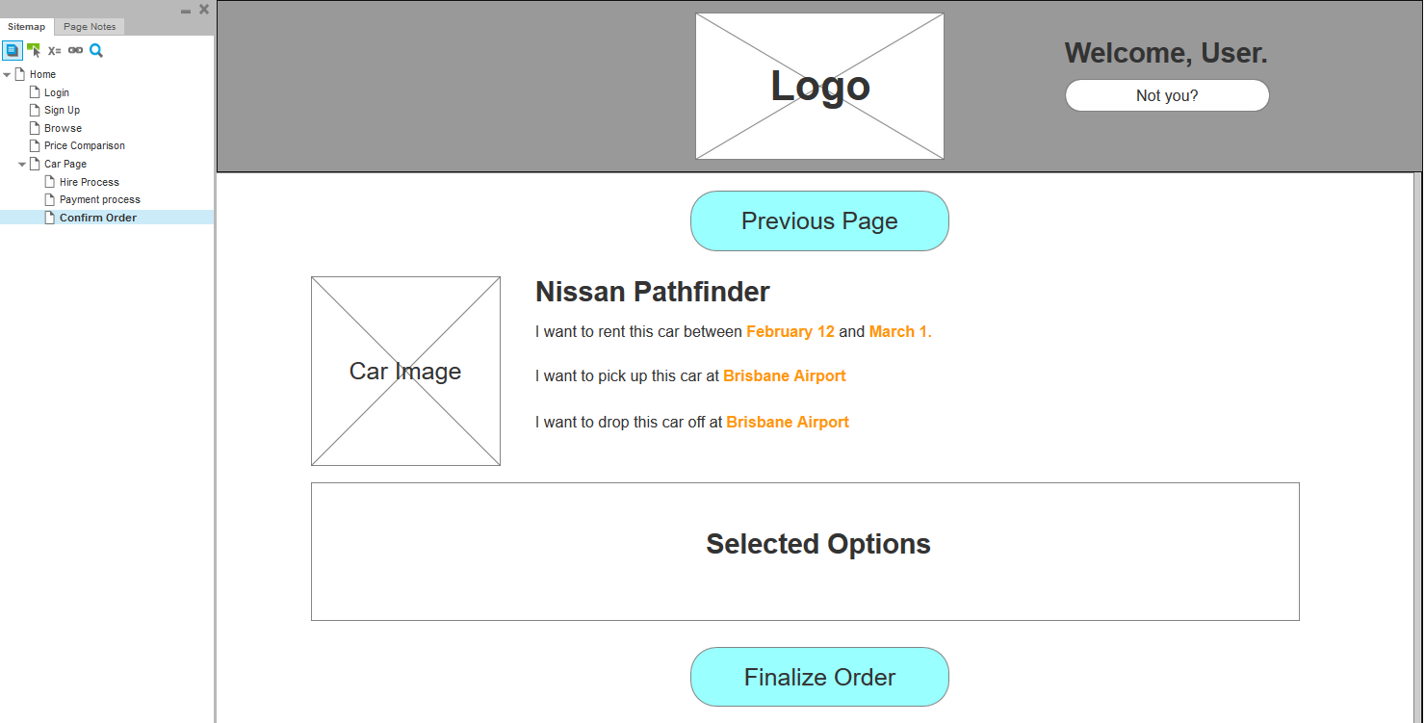
Prototyping
Notes:
Early on in the project, after interviews and requirements were complete, we started prototyping.
Sketches helped develop the flow of pages.
Rapid prototyping tool provided high fidelity prototype

Slide 5
Our research and design
Market Trends
Simplistic UI
Shows the user the key information straight away
Nice to haves
Recommended Cars
Live help chat window
Optional add-ons
Reward System
Notes:
After researching many of the top car hire websites there were several identifiable market trends that we followed through into the design

Slide 6
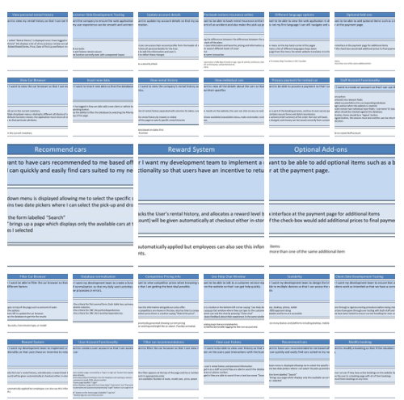
Brainstorming
Notes:
A small amount of the total user stories

Slide 7
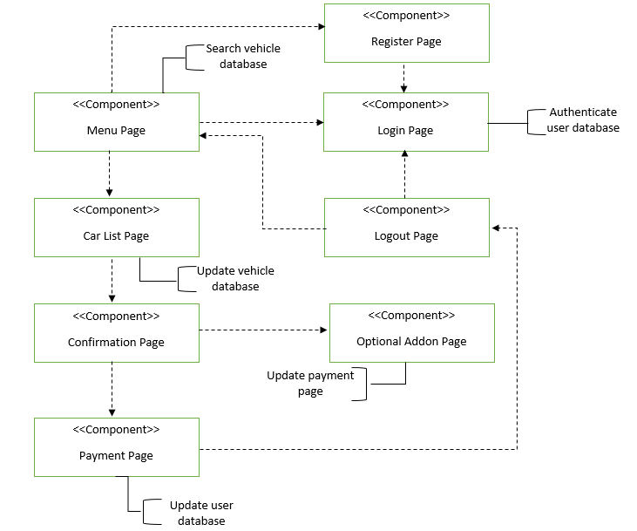
Component Diagram
Notes:
The component diagram gives us an example of of the important components that that are used to make the features

Slide 8
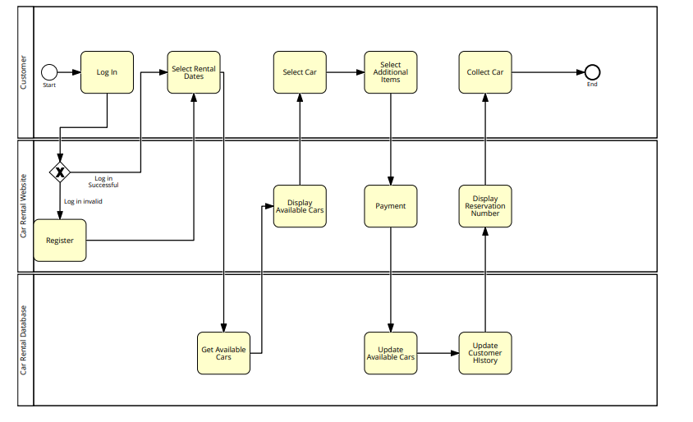
BPMN
Notes:
Shows the process that the customer takes and all their interactions from logging into the renal car website to collecting the car.

Slide 9
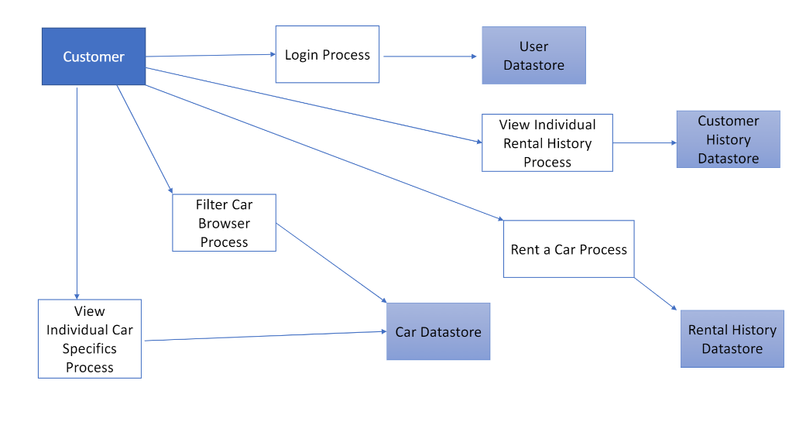
Dataflow Diagram
Notes:
This diagram that shows how the data in system will move and what datastores it will interact with.
It is an overview of the system

Slide 10
Functionality
Register
Login
Search
Company Rental History Database
Add new entries to database
User History Database

Slide 11
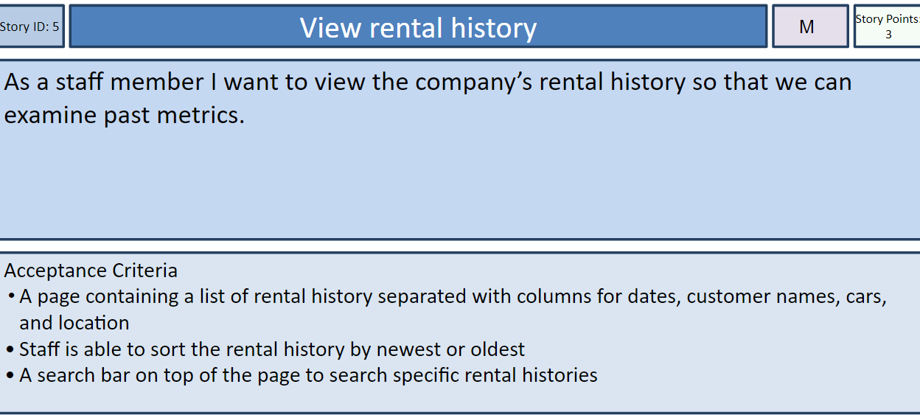
Testing - Acceptance Criteria

Slide 12
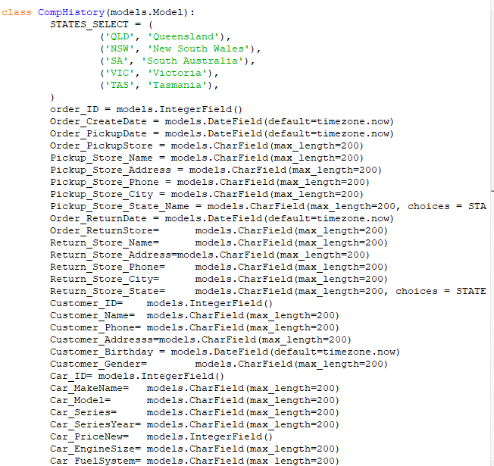
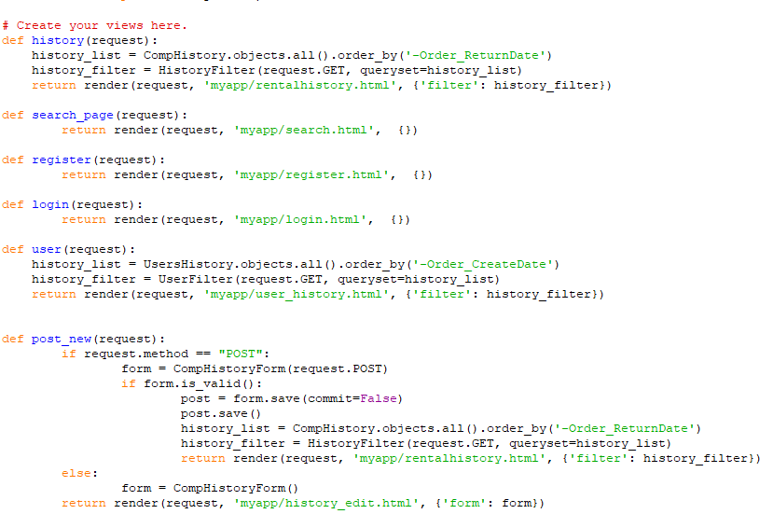
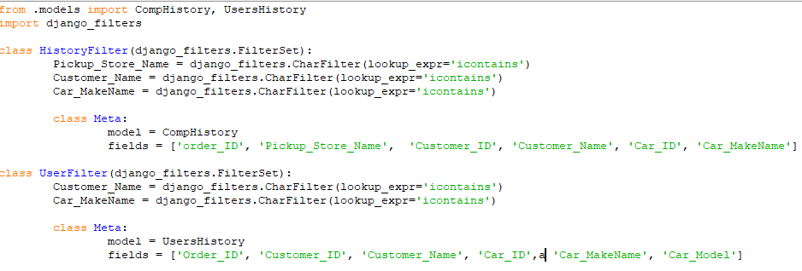
Testing - Database Unit, Integration

Slide 13
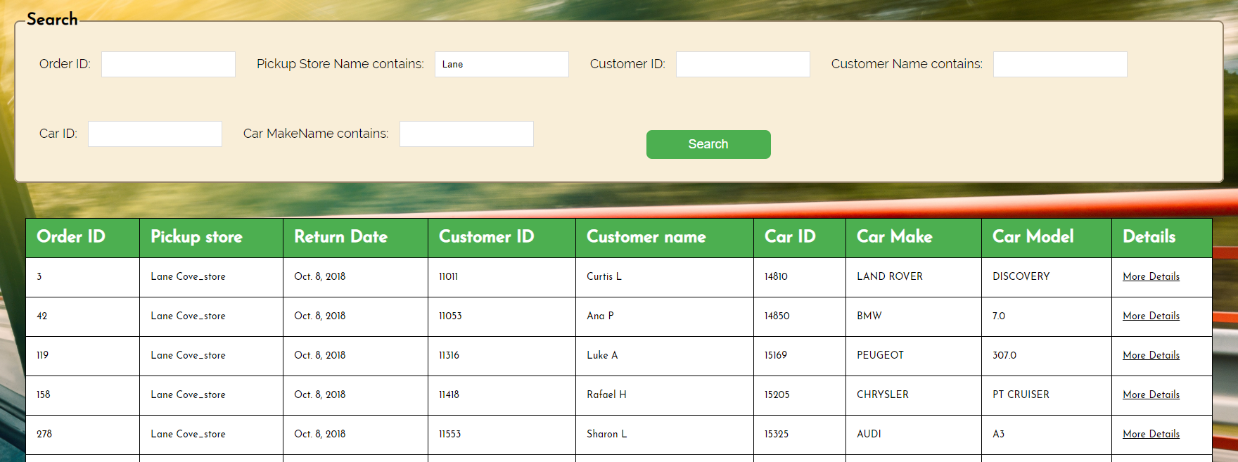
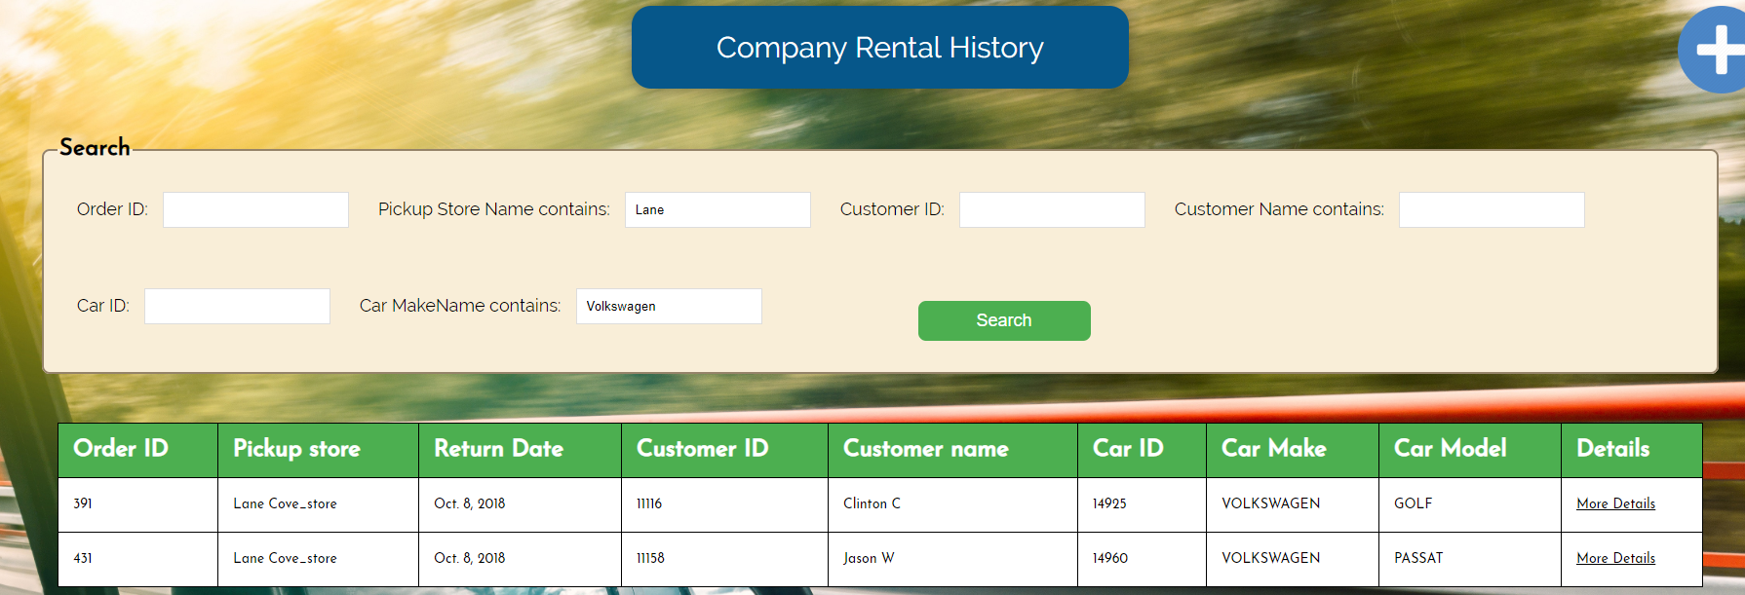
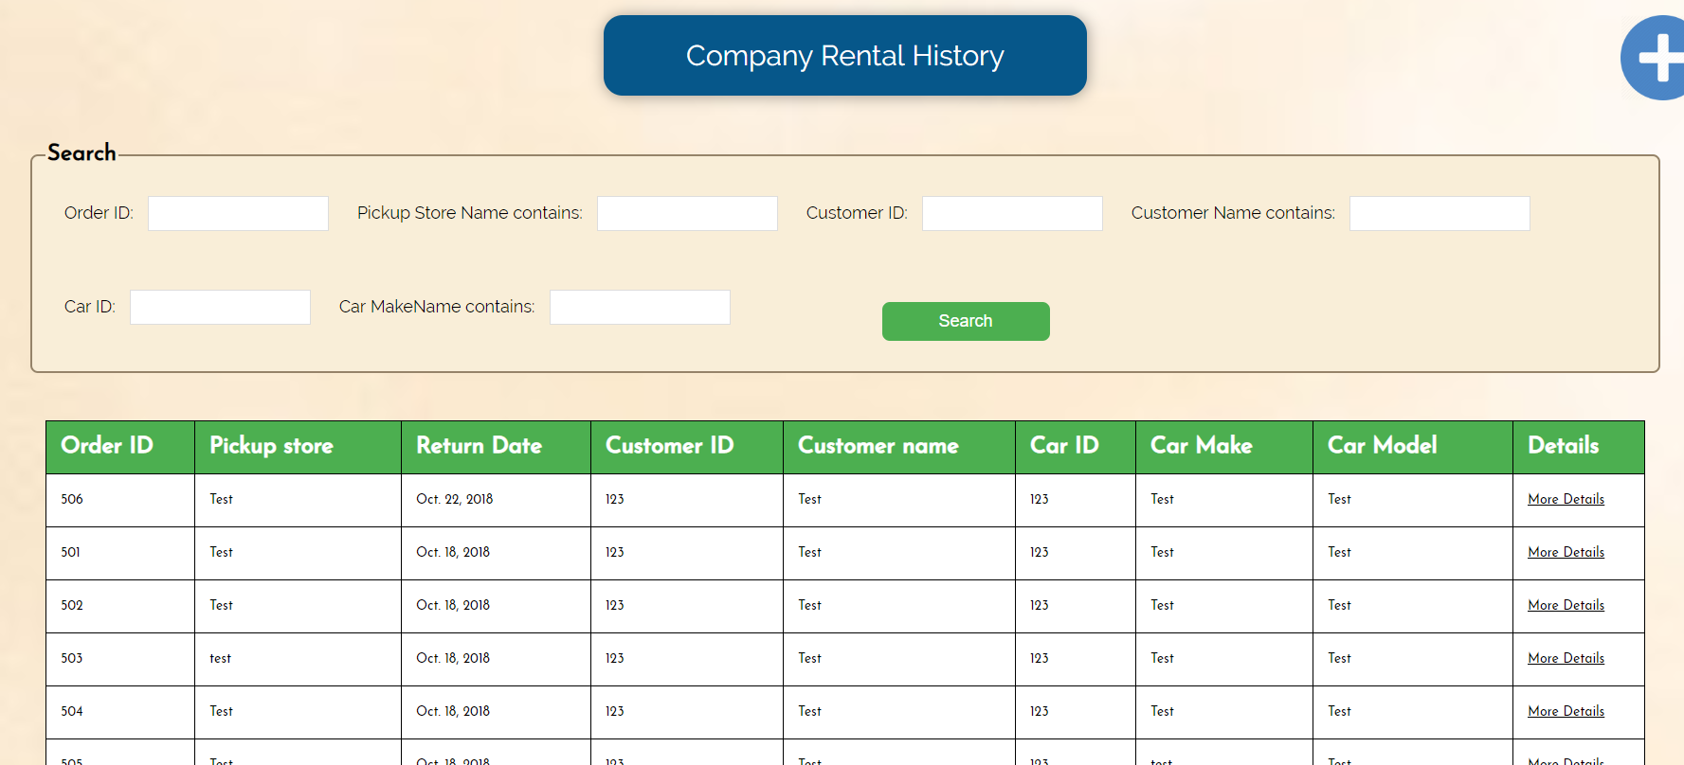
Testing

Slide 14
What will happen in the future?
Vehicle Add-ons & Extras
Rewards system
Live help chat
Language & scalability options
Competitive pricing comparison

Slide 15

Thanks for Listening!

